Slide 1

Formation of electronic devices requires putting together two or more dissimilar materials (semiconductors, metals, insulators). The interface between these materials becomes crucial because it affects the electrical propertie(transport) of the devices. This interface is called the junction.
An ideal junction is one where there are no defects formed at the interface.
Forming ideal junctions is challenging and most real materials have defects at the interface which can affect the electronic properties.

Slide 2
Consider a junction formed between 2 metals with different work functions, as shown
Metals are characterized by an incomplete energy band (valence and conduction band
overlap) with the top of the energy band being the Fermi energy.
The distance from the Fermi level to the vacuum level is called the work
function (φ).
the two metals are Pt and Mo with work functions of 5.36 and 4.20 eV respectively.
Actual junctions are formed usually by vapor deposition of one metal on top of the other.
Usually some form of post deposition annealing is also used to form the interface and
reduce defect density.
The most important rule when a junction is formed is that the Fermi levels must line
up at equilibrium (no external bias). This can be understood by using figure where
there are electrons in Mo at a higher energy level than those in Pt.

Slide 3
These electrons can occupy the empty energy levels located above the Pt
Fermi level.
Because electrons move from Mo to Pt a net positive charge
develops on the Mo side and a net negative charge on the Pt side.
Thus, a contact potential is developed at equilibrium between the two
metals.
This contact potential is related to the difference in the work functions, and
is shown in figure 2.
For Mo-Pt junction the contact potential is 1.16 V .

Slide 4

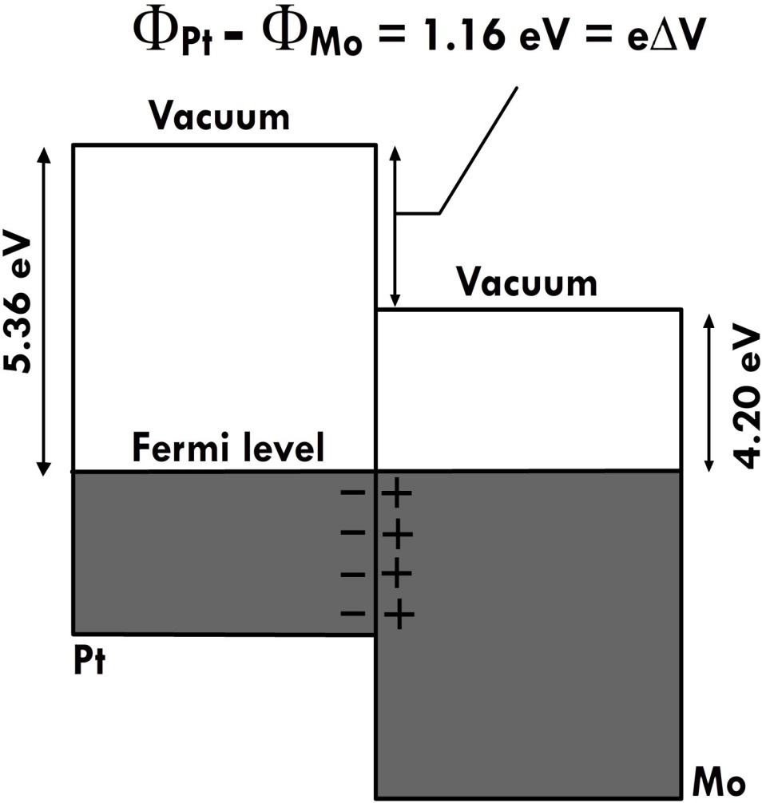
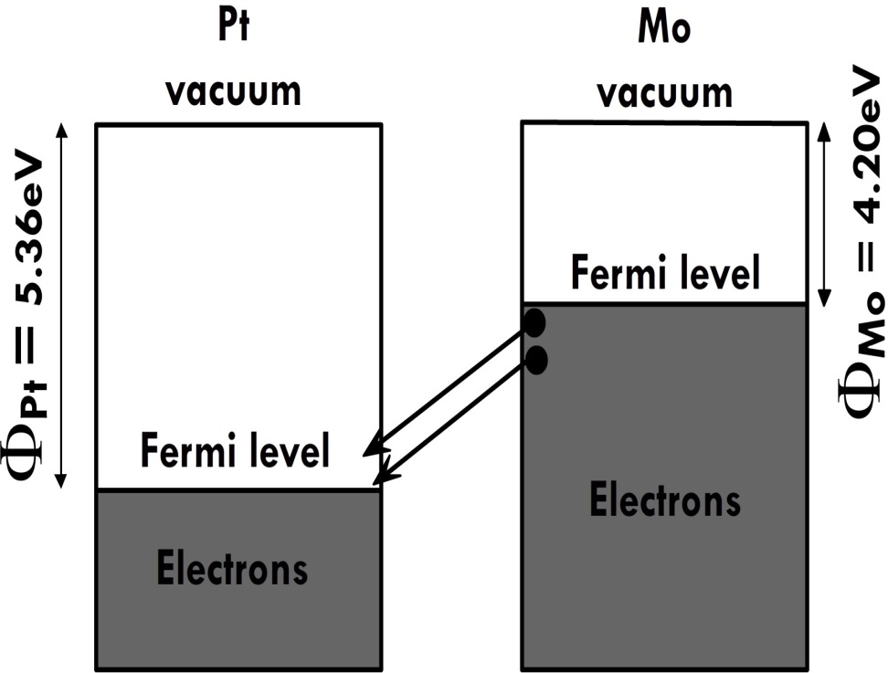

Slide 5
When a metal and semiconductor are brought into contact, there are two types of junctions formed depending on the work function of the semiconductor and its relation with the metal
1.Schottky junction - φ_{m} > φ_{semi}
2.Ohmic junction φ_{m}< φ_{semi}

Slide 6
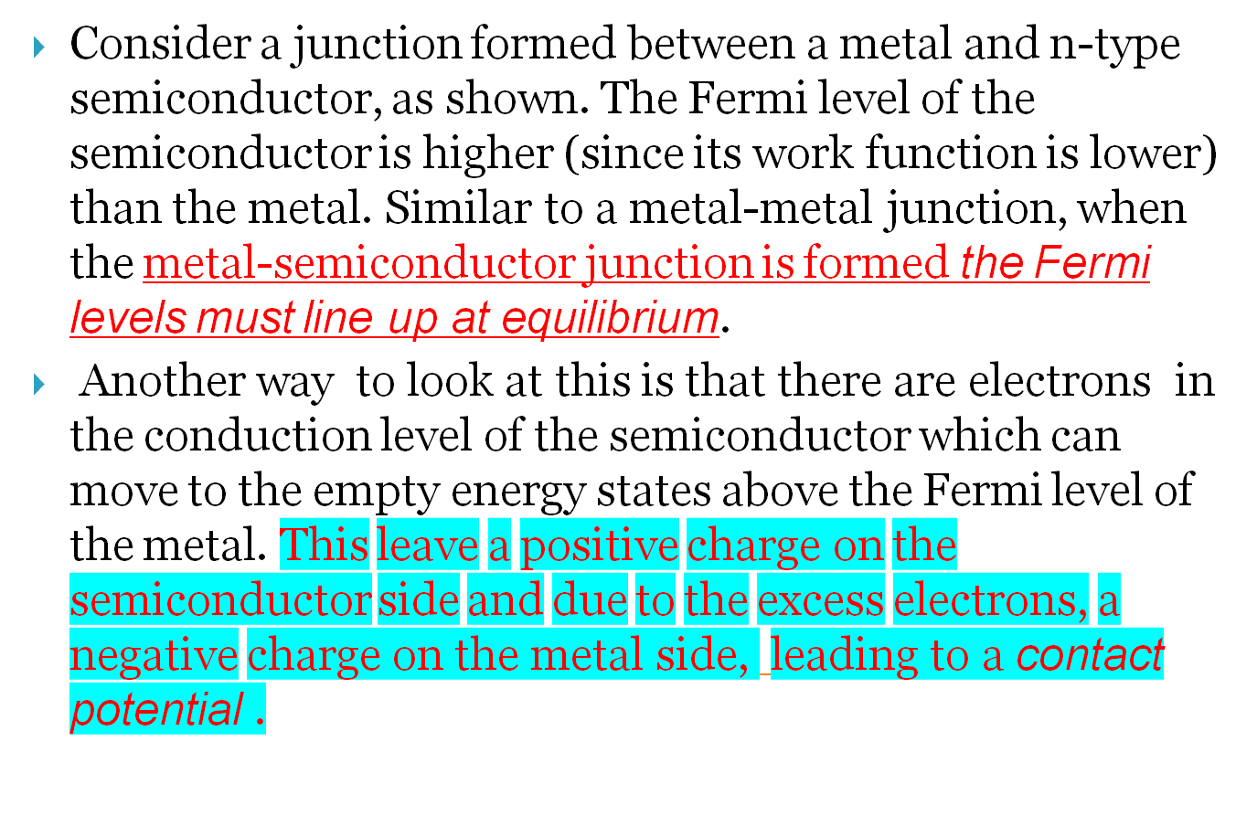

Slide 7
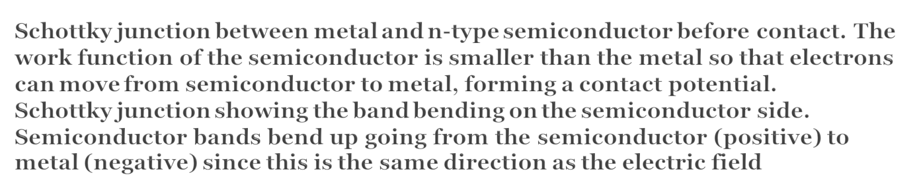
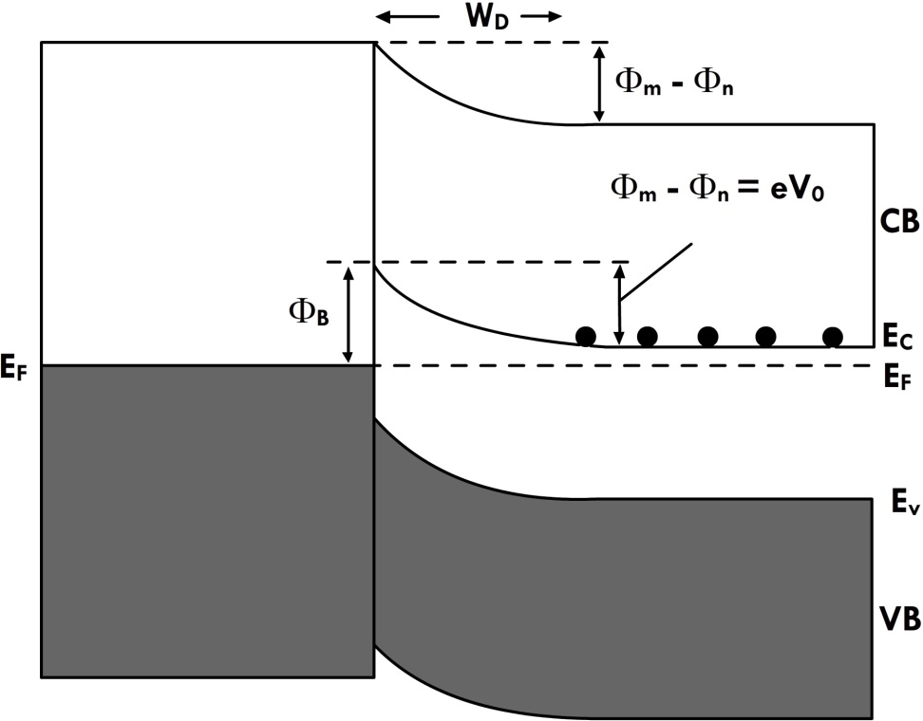
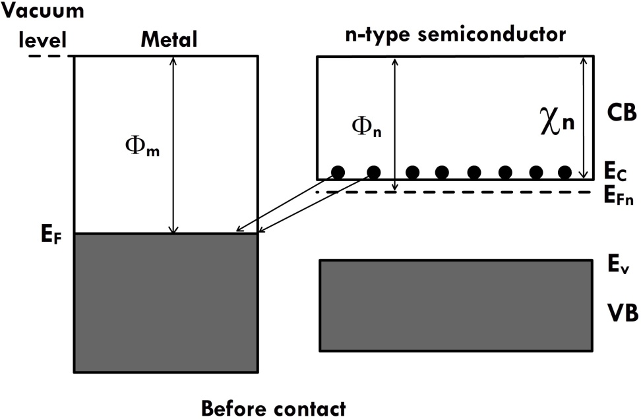

Slide 8
When a contact is formed between two metals, the charges reside on the surface. This is due to the high electron density found in metals (typically 10²² cm⁻³).
On the other hand, when a contact is formed between a metal and semiconductor, due to the low charge density on the semiconductor side (typically 10¹⁷ cm⁻³) the electrons are removed not only from the surface but also from a certain depth within the semiconductor
This leads to the formation of a depletion region within the semiconductor

Slide 9
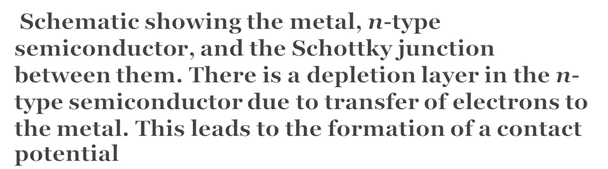
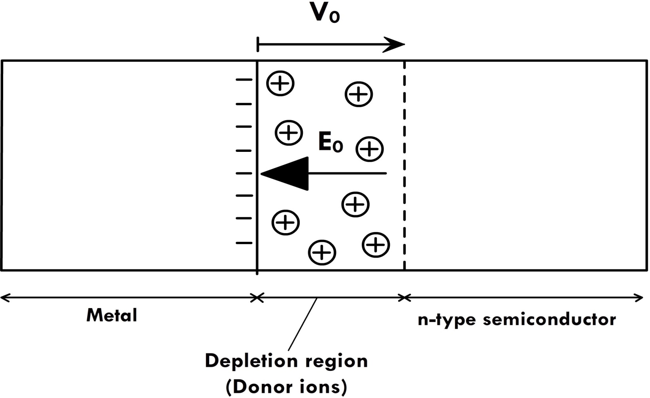

Slide 10
Thus, when a Schottky junction is formed between the metal and
semicon- ductor, the Fermi level lines up and also a positive potential is
formed on the semiconductor side.
Because the depletion region extends within a certain depth in the
semiconductor there is bending of the energy bands on the semi- conductor
side.
Bands bend up in the direction of the electric field (field goes from positive
charge to negative charge, opposite of the potential direction). This means
the energy bands bend up going from n-type semiconductor to metal, shown
in fig.

Slide 11
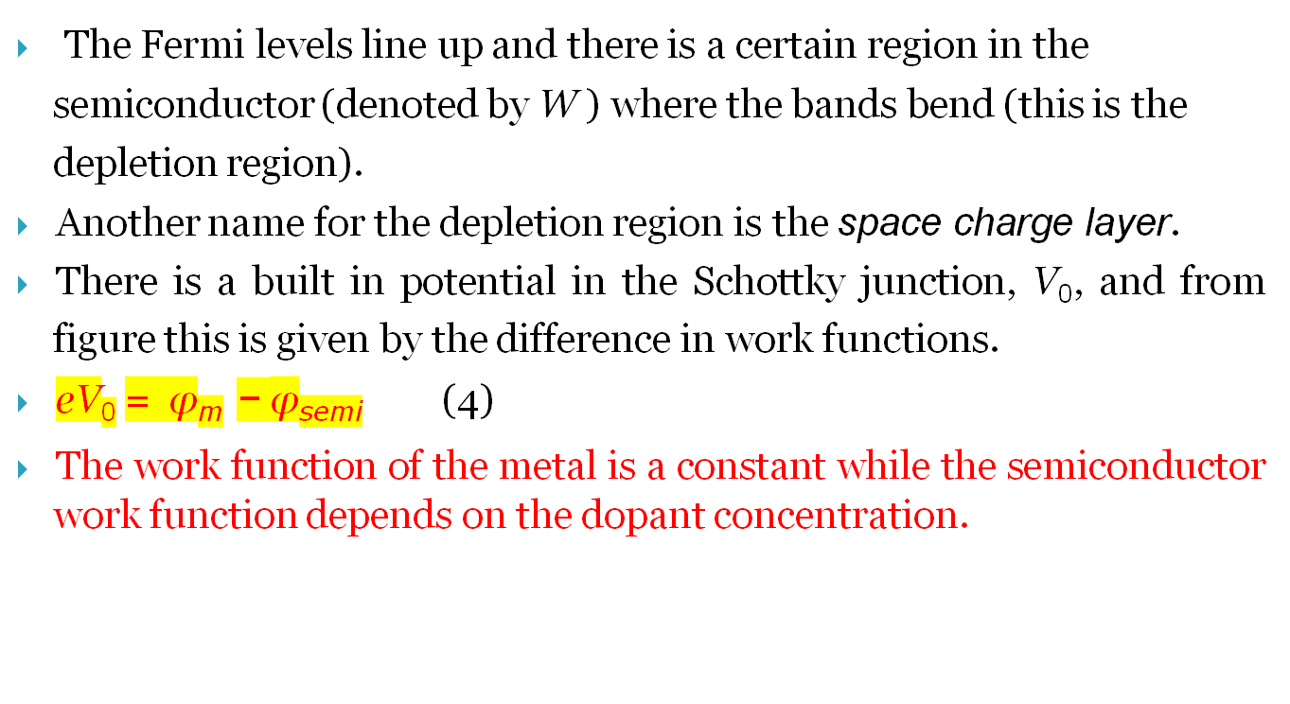

Slide 12
The contact potential then represents the barrier for the electrons to move from the n-type semiconductor to the metal. Initially, when the junction is formed electrons move to the metal to create the depletion region. The contact potential thus formed prevents further motion of the electrons to the metal.There is also a barrier for electrons to move from metal to semiconductor.
This is called the Schottky barrier and denoted by φ_{B} in figure.
At equilibrium the motion of electrons from the
semiconductor to metal is
balanced by the contact potential so that there is no net current. The Schottky junction can be biased by application of an external potential. There are two types of bias
.

Slide 13
Forward bias - metal is connected to positive terminal and n-type semi- conductor connected to negative terminal
Reverse bias - metal is connected to negative terminal and n-type semi- conductor connected to positive terminal
The current flow depends on the type of bias and the amount of applied external potential

Slide 14
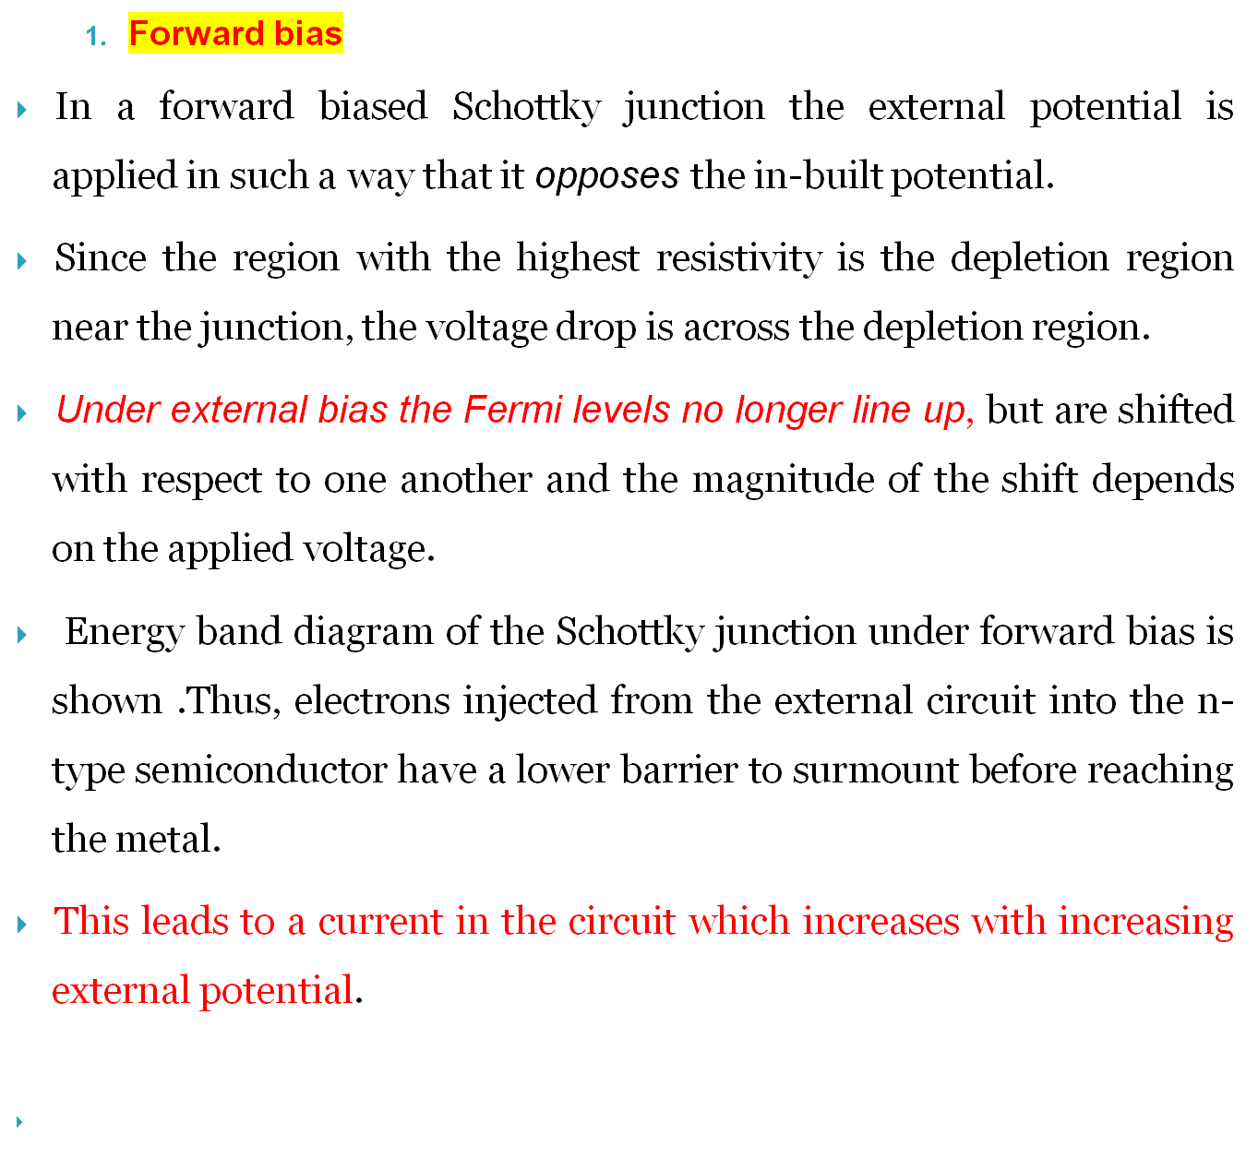

Slide 15
The current in a Schottky diode under forward bias is given by
J = J₀ [exp(eV/ k_{B} T)-1 (6)
where J is the current density for an applied potential of V . J₀ is a constant
and depends on the Schottky barrier (φ_{B}) for the system and the expression is
J₀ = AT² exp(-φ_{B}/ k_{B} T (7)
where A is the Richardson constant for thermionic emission and is a material property. Equation 6 shows that in the forward bias the current exponentially increases with applied potential.

Slide 16
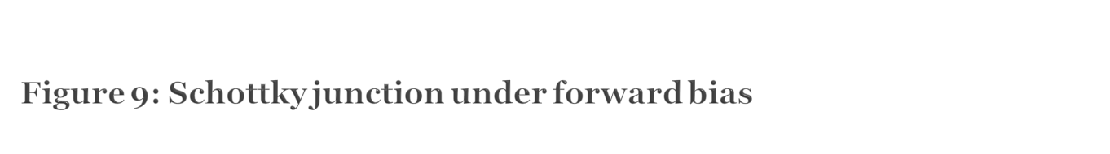
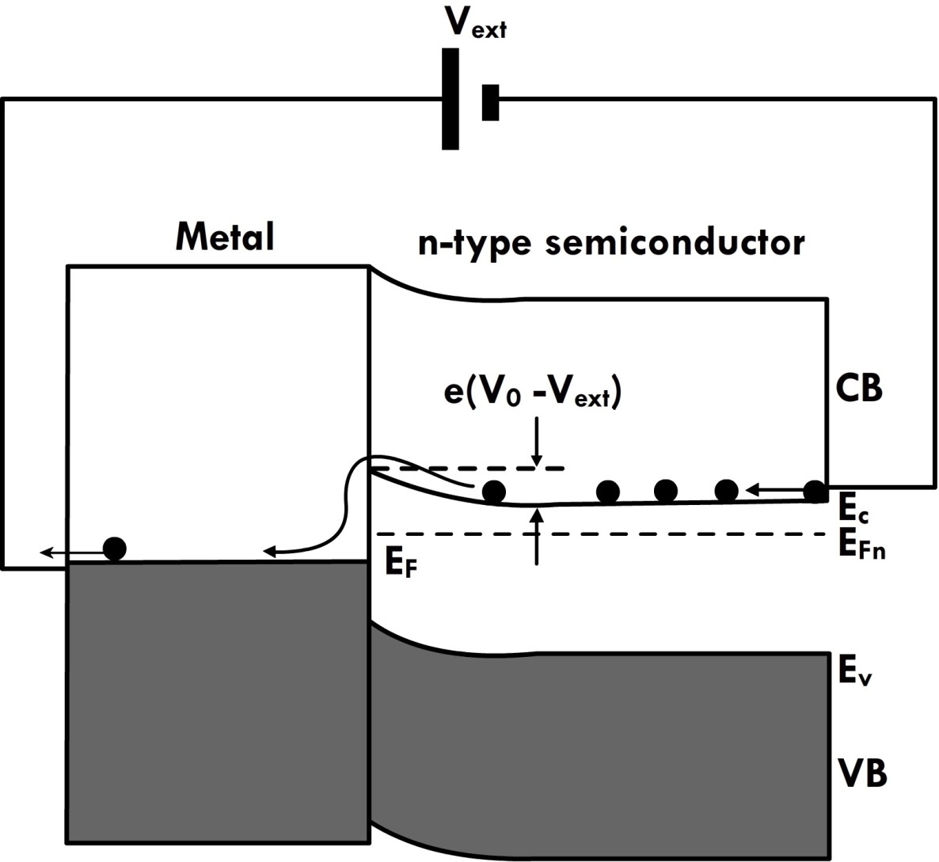

Slide 17
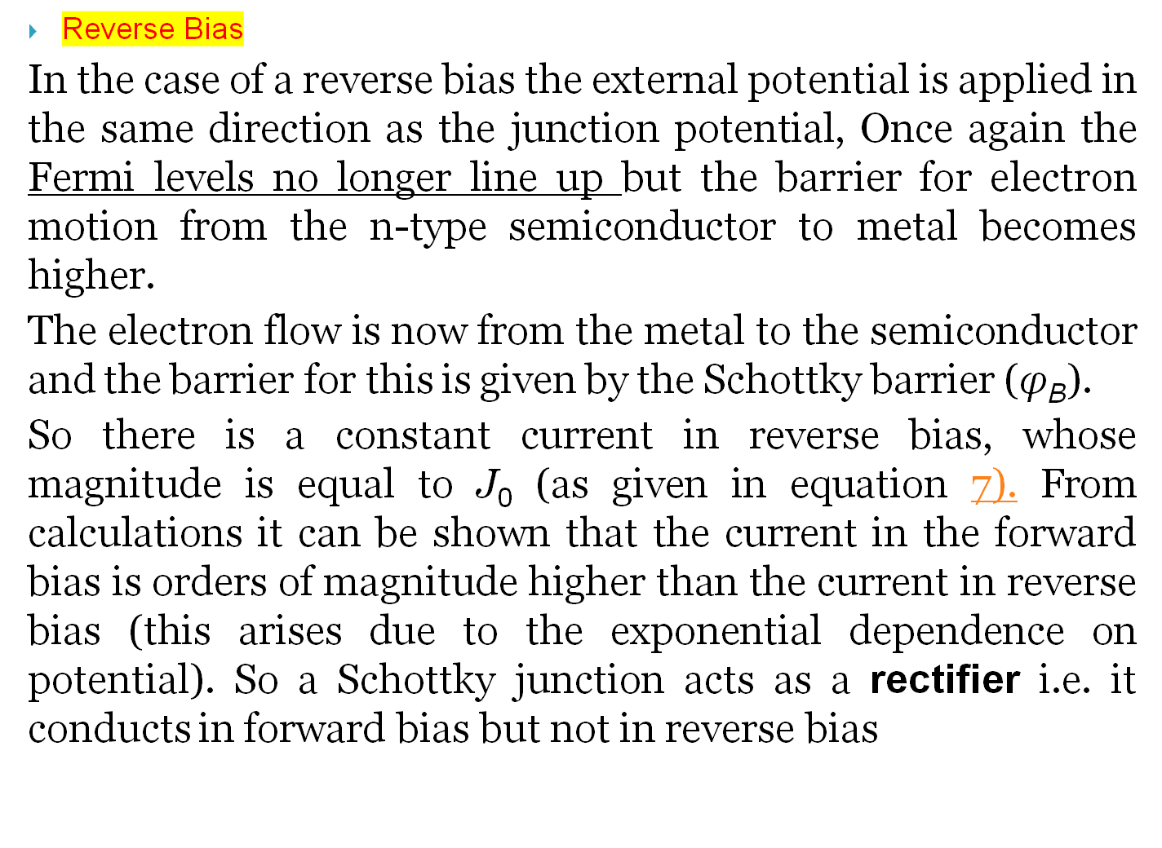

Slide 18
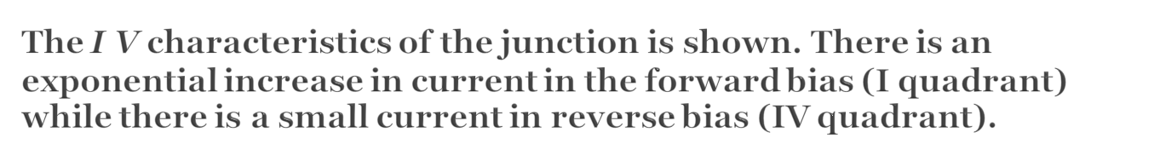
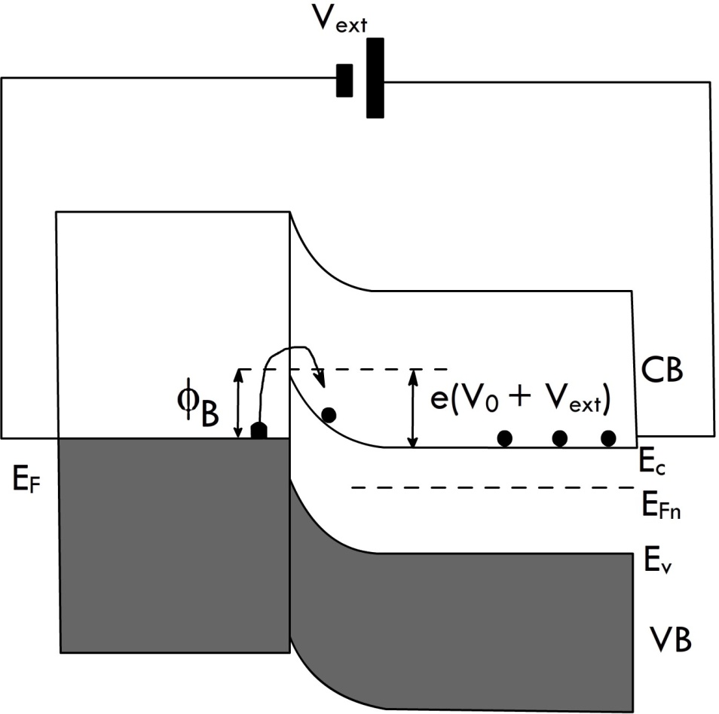
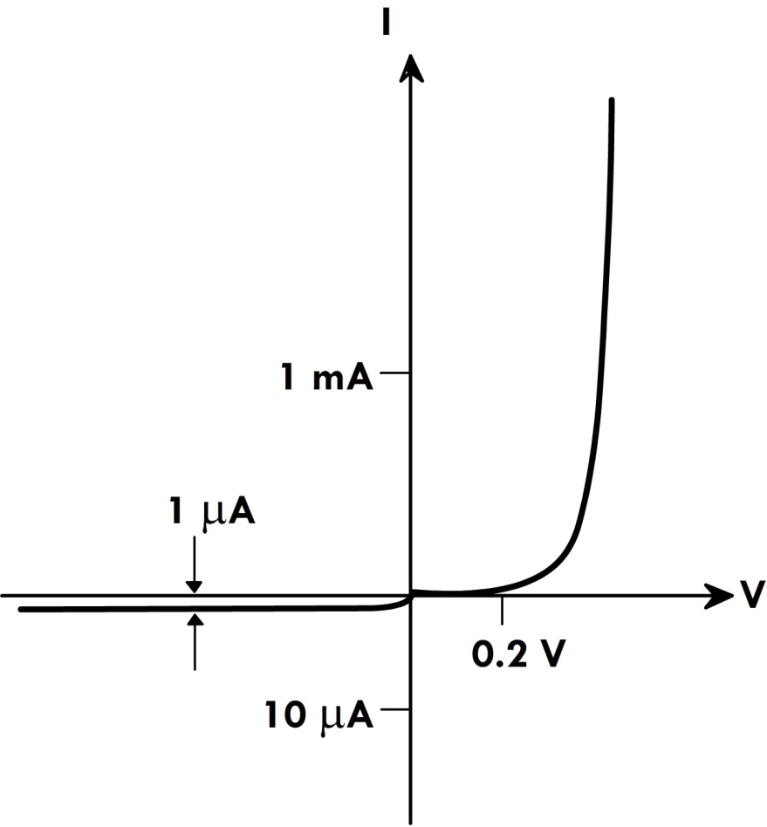
Schottky junction under reverse bias
I V characteristics of a Schottky junction showing rectifying properties

Slide 19

A Schottky junction is formed when the semiconductor has a lower work function than the metal.
When the semiconductor has a higher work function the junction formed is called the Ohmic junction.
Once again it is possible to draw the energy band diagram of the junction in equilibrium (Fermi levels line up). At equilibrium, electrons move from the metal to the empty states in the conduction band so that there is an accumulation region near the interface (on the semiconductor side). The accumulation region has a higher conductivity than the bulk of the semiconductor due to this higher concentration of electrons.
Thus, a Ohmic junction behaves as a resistor conducting in both forward and reverse bias. The resistivity is determined by the bulk resistivity of the semiconductor.

Slide 20
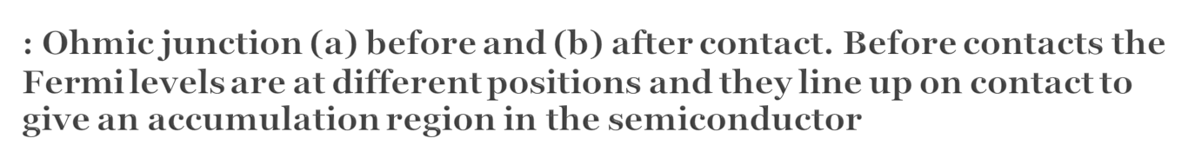
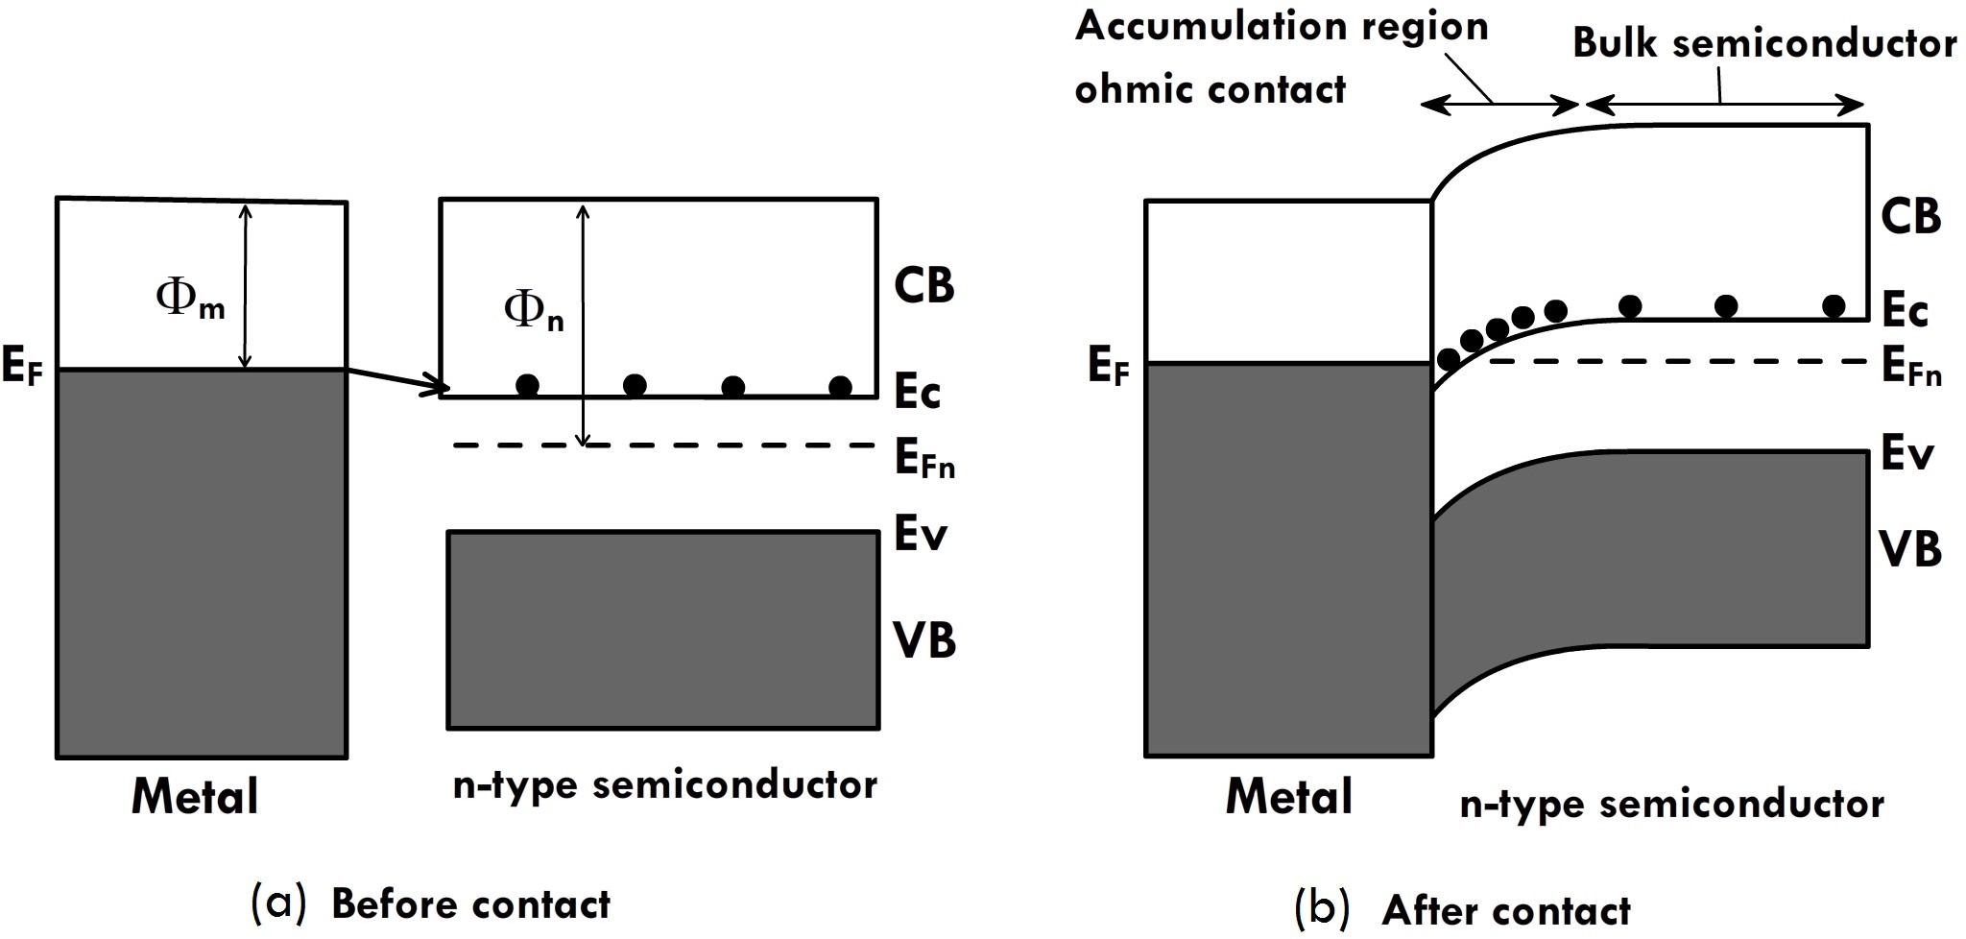

Slide 21
One of the interesting applications of Ohmic junctions is in thermoelectric devices, where a small volume can be cooled by application of direct currents. For Ohmic junctions, depending on the direction of current flow (forward or reverse biass), heat can be generated or absorbed. This is called Peltier effect and is applicable to junctions between any two dissimilar materials. So, when current flows through a metal semiconductor Ohmic junction, heat will always be released or absorbed. This can be used as a practical cooling device, Both p- and n- type semiconductors are used and the current flow is such that one end is always cold (heat absorbed) while the other end is hot (heat released).

Slide 22
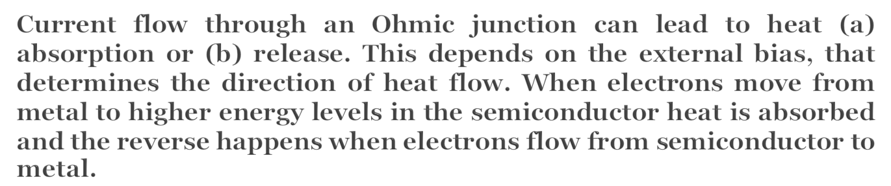
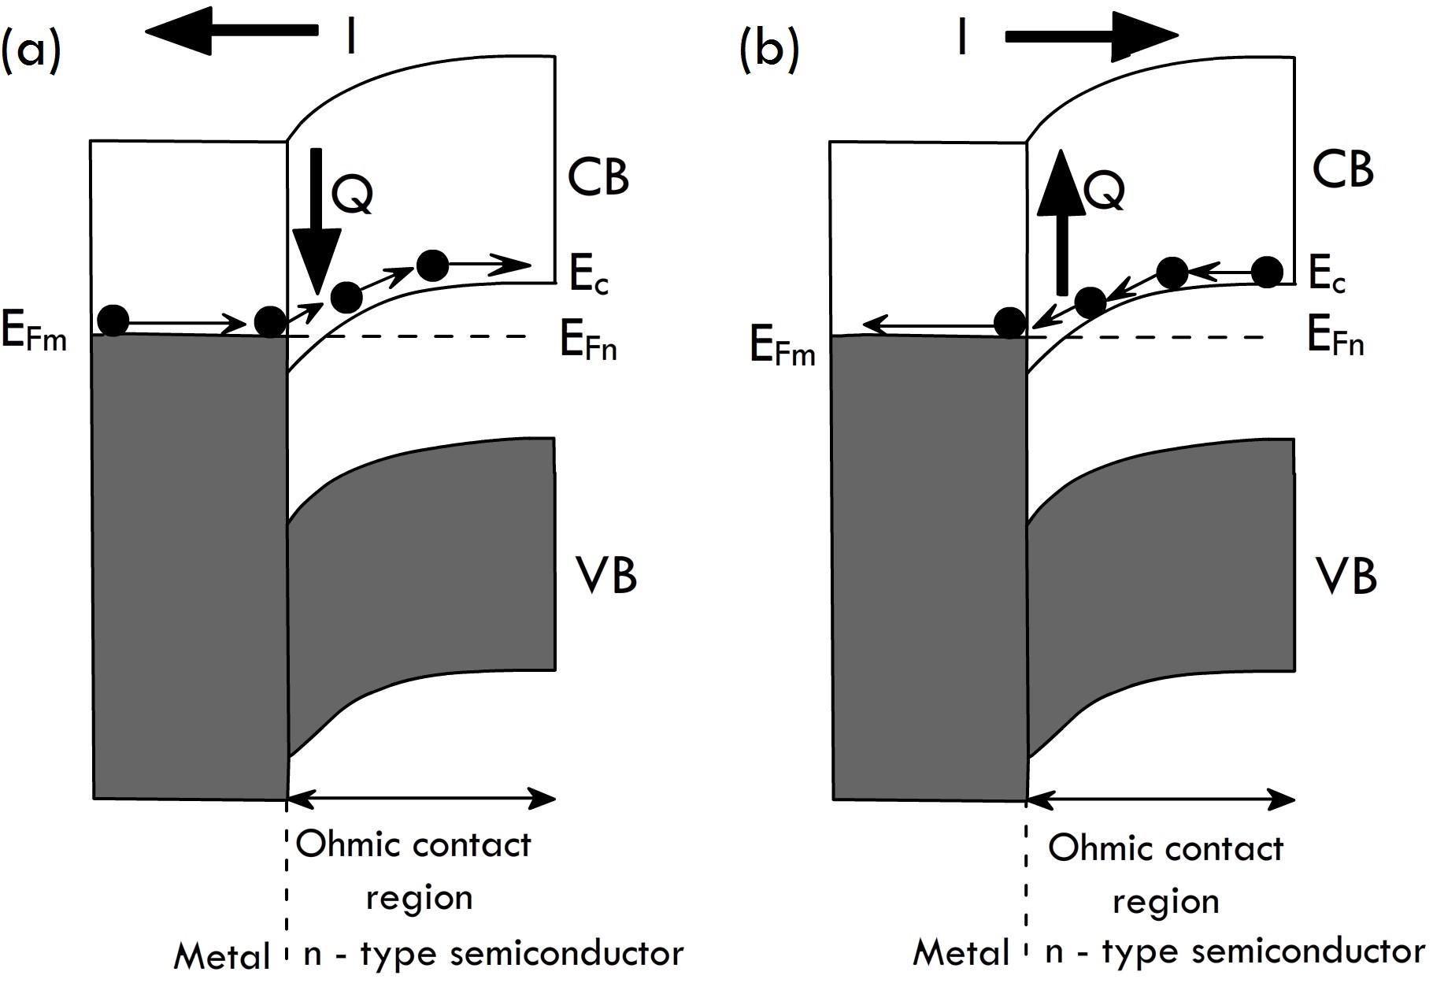

Slide 23

There are different metals that form Ohmic contacts with semiconductors.
For Si, earlier Al was used for making electricalthen replaced by Al-Cu alloys. Both form Ohmic contacts with Si. These have now been replaced by Cu (higher conductivity). But, Cu is poisonous to Si and hence cannot directly come into contact with the semiconductor. Usually, Ti or TiN is used to make electrical contact with Si, and then Cu is deposited. Ti or TiN is chosen because it also forms Ohmic contacts with p and n type Si

Slide 24
For integrated devices electrical contacts to the outside circuit components are done using evaporated metals and Ohmic contacts are formed. This is because the electrical contact should not impose a rectifying behavior on the device.
Thermal processing of metal-semiconductor contacts can lead to inter-diffusion and formation of metal silicides. Pt-Si forms a number of silicide phases like PtSi, Pt₂Si, and Pt₃Si.
Similarly, Ti-Si forms TiSi₂, Ti₂Si, and Ti₃Si. Thus the contact is no longer between a metal-semiconductor but between a silicide-semiconductor. This can affect the electrical properties of the junction.

Slide 25
The Peltier Effect
The effect creates a temperature difference by transferring heat between two electrical junctions.
A voltage is applied across joined conductors to create an electric current.
When the current flows through the junctions of the two conductors, heat is removed at one junction and cooling occurs.

